Slide 1
STATE DESIGN PATTERN

Slide 2
Problem
Naive solution and assessment
Introduction of state design pattern
UML
Sample implementation
Use cases and other applications
Pros/Cons

Slide 3
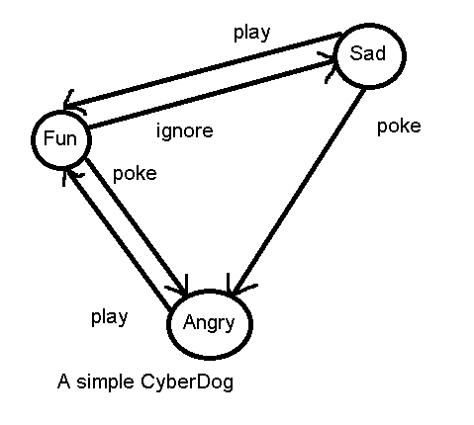
Problem
Suppose we want to implement CyberDog as follow:

Slide 4
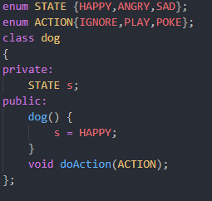
Naive solution

Slide 5
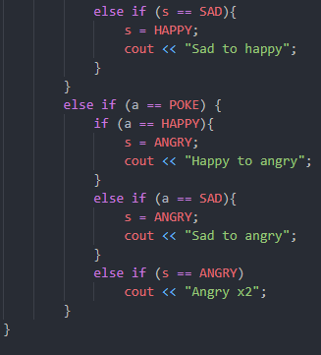
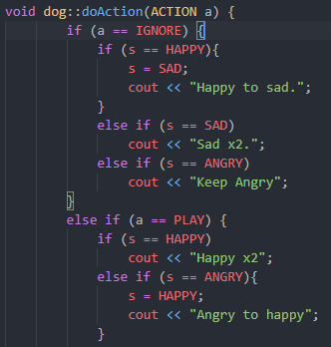
Naive solution
Using if-else or switch-case statements

Slide 6
Assessment
Many conditional statements → More complicated when getting more states/actions
Hard to maintain

Slide 7
Introduction to State DP
Behavioral design pattern
State design pattern allows an object to adjust its behaviors whenever internal states changes. The object will appear to change its class.

Slide 8
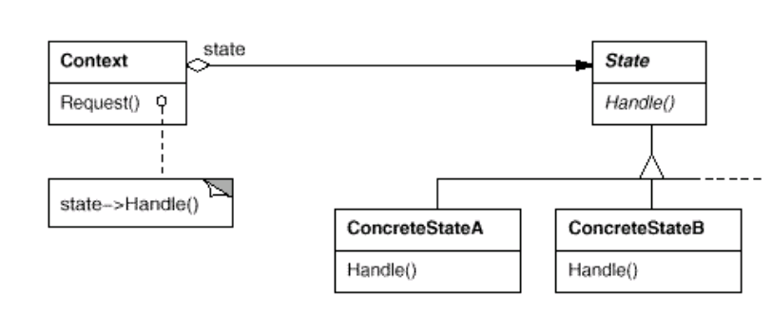
Structure
Notes:
Context
defines the interface of interest to clients.
maintains an instance of a ConcreteState subclass that defines the current
state.
State
defines an interface for encapsulating the behavior associated with a
particular state of the Context.
ConcreteState subclasses
each subclass implements a behavior associated with a state of the
Context.

Slide 9
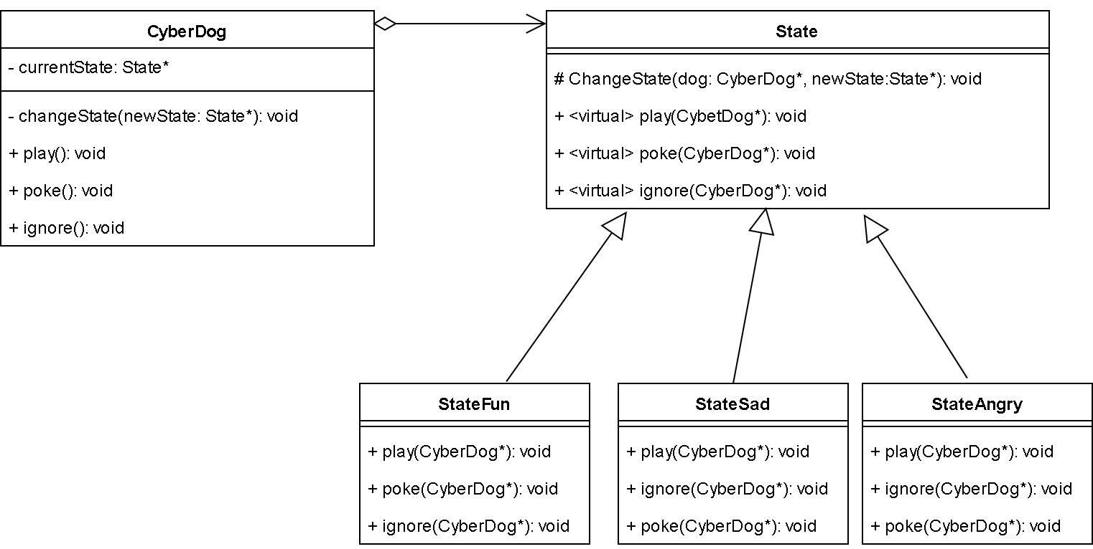
UML class diagram

Slide 10
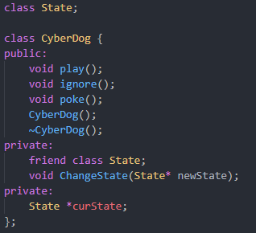
Implementation
CyberDog Class (Definitions)

Slide 11
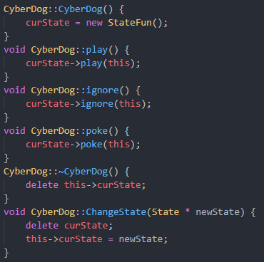
Implementation
CyberDog behaviors

Slide 12
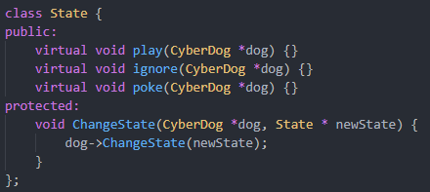
Implementation
State class

Slide 13
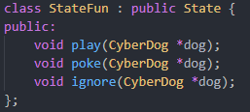
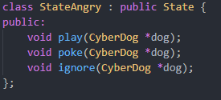
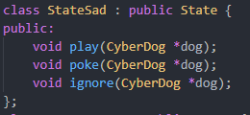
Implementation
StateFun, StateAngry, StateSad classes inherits State class

Slide 14
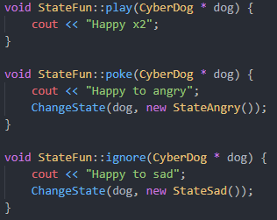
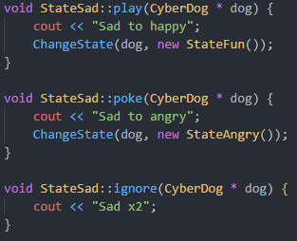
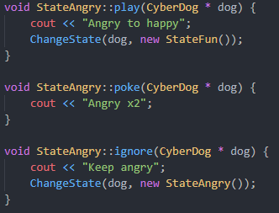
Implementation
Behaviors of subclasses

Slide 15
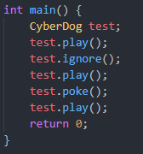

Implementation
Example
Result

Slide 16
Use cases
An object’s behavior depends on its state.
When using similarly structural object’s state-depended multipart conditional statements → Each branch of condition is a separate class.

Slide 17
Other application
State machine (vending machine)
TCP problem
Game AI
Game problem

Slide 18
Pros
Minimize condition statements complexity.
Easy to maintain codes
More specific
More encapsulated
Explicit state transition
State objects can be shared (if no instance variables)

Slide 19
Cons
Need a class for every state → not suitable for small number of cases (overkill)
More resources
Memory leaks as if not handling probably

Slide 20
Furthermore
Can be used with flyweight, and singleton design pattern

Slide 21
References
Design Patterns: Element of reusable of object-oriented software
https://springframework.guru/gang-of-four-design-patterns/state-pattern/
https://sourcemaking.com/design_patterns/state/cpp/1
Head first design pattern
https://medium.com/swlh/vending-machine-design-a-state-design-pattern-approach-5b7e1a026cd2

